Slide 1

THE UNIVERSITY OF TENNESSEE, KNOXVILLE
DATA xUTK 2026 · DISCOVERY
Beyond the Grade
Using AI-assisted speech evaluation to build meaningful data
for instruction and program assessment
Anna Lyn McClure, PhD
Technical Documentation Specialist · Office of Communications and Marketing
University of Tennessee, Knoxville
Worked example: SpeechGradebook (ValidBound)
Data xUTK 2026 · Discovery · University of Tennessee, Knoxville
1 / 23
Notes:
Title slide. Beyond the Grade: Using AI-assisted speech evaluation to build meaningful data for instruction and program assessment. Anna Lyn McClure, PhD, Technical Documentation Specialist, Office of Communications and Marketing, University of Tennessee, Knoxville. Worked example: SpeechGradebook by ValidBound. Data xUTK 2026, Discovery theme.

Slide 2
ROADMAP
What we’ll cover
01
Time & capacity
The listening load behind speech evaluation
02
What data can capture
Structured records with instructor as grader of record
03
Instructors & administrators
How each stakeholder uses the data
04
Pilot lessons
Barriers, Canvas, adoption conditions
05
Learning outcomes
Linking survey constructs to performance evidence
Data xUTK 2026 · Discovery · University of Tennessee, Knoxville
2 / 23
Notes:
Roadmap: time and capacity; what data can capture; instructors and administrators; pilot lessons; linking learning outcomes to performance evidence.

Slide 3
CAPACITY CONSTRAINT
How a semester of speeches adds up
≈ 54
hours
~7 min
average speech length (listening)
× 5
assignments per student
Listening only—before scoring or written feedback
× 23
students per class
Illustrative full teaching load.
Constraint = capacity, not instructor care or skill.
× 4
classes in a teaching load
7 × 5 × 23 × 4 = 3,220 minutes ≈ 54 hours
Data xUTK 2026 · Discovery · University of Tennessee, Knoxville
3 / 23
Notes:
Capacity constraint. Illustrative full teaching load: about 7 minutes times 5 assignments times 23 students times 4 classes equals 3,220 minutes, about 54 hours of listening only before scoring or written feedback. Constraint is capacity, not instructor care or skill.

Slide 4
DATA INFRASTRUCTURE
Rich judgment is produced.
Little of it becomes reusable data.
What teaching produces
What institutions usually keep
• Video performances
Kept
Letter or total grade
• Delivery behaviors
Kept
Sometimes a rubric total
• Content & organization quality
Kept
End-of-term survey LO deltas
Rare
Category patterns by section
• Instructor judgment
Rare
Speech-to-speech trends
• Written feedback & rubric scores
Rare
Comparable section evidence
Data xUTK 2026 · Discovery · University of Tennessee, Knoxville
4 / 23
Notes:
Data infrastructure gap. Teaching produces video, delivery behaviors, content and organization quality, instructor judgment, and written feedback—but institutions usually keep only a letter or total grade, sometimes a rubric total, and end-of-term survey learning-outcome deltas. Category patterns and speech-to-speech trends are rare.

Slide 5
RESEARCH FOUNDATION · McClure (2025)
What longitudinal LO assessment already showed
Overall gains
Section variation
Pre→post surveys show movement in competence and related outcomes at the program/course level.
Students often enter similarly but exit at different levels by section—under a shared curriculum.
Course context
Measurement gap
CMST 210 and 240 are not interchangeable; apprehension patterns differ by course context.
Survey snapshots alone leave instructors without mid-course performance evidence admins can also compare.
Data xUTK 2026 · Discovery · University of Tennessee, Knoxville
5 / 23
Notes:
Research foundation from McClure 2025: overall gains on surveys; section variation in exits under a shared curriculum; course context differences such as CMST 210 versus 240; measurement gap—surveys alone leave instructors without mid-course performance evidence.

Slide 6
PRIMARY DATA USERS
PRIMARY DATA USERS
Instructors
Administrators
• What patterns help me teach the next speech?
• Comparable evidence across sections and terms?
• Category-level section profiles
• Do course contexts differ (e.g., 210 vs 240)?
• Speech-to-speech trends
• Evidence beyond survey-only LO reports
• AI draft → refine to reclaim time for judgment
• Supportive discovery—not public ranking
Data xUTK 2026 · Discovery · University of Tennessee, Knoxville
6 / 23
Notes:
Primary data users. Instructors ask what patterns help teach the next speech and use category profiles and AI draft-then-refine. Administrators ask for comparable evidence across sections and terms and evidence beyond survey-only reports, for supportive discovery not public ranking.

Slide 7
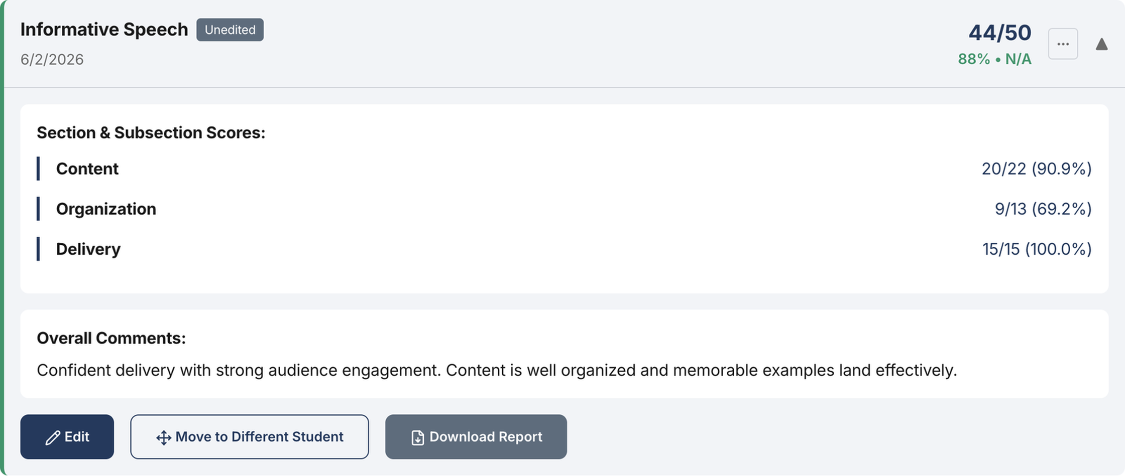
A WORKED EXAMPLE
One response: AI drafts, instructors decide
SpeechGradebook · Rubric-based · Qwen 2.5 draft · Instructor is grader of record · Exportable data
Evaluation review — scores, comments, instructor controls (SpeechGradebook Pro)
Data xUTK 2026 · Discovery · University of Tennessee, Knoxville
7 / 23
Notes:
Worked example: SpeechGradebook. Rubric-based AI draft with Qwen 2.5; instructor is grader of record; exportable data. Screenshot shows evaluation review with scores, comments, and instructor controls.

Slide 8
DATA MODEL
An evaluation as a data record—not only a grade
Context
Rubric scores
Comments
Course · section · assignment · term
Categories and criteria with point values
Per-category + overall; instructor voice retained
Performance signals
Judgment trail
Export
Transcript · delivery observations
Model draft vs. instructor-final refinements
CSV / reports for instruction and assessment
Data xUTK 2026 · Discovery · University of Tennessee, Knoxville
8 / 23
Notes:
An evaluation as a data record: context, rubric scores, comments, performance signals, judgment trail from model draft to instructor-final, and export for instruction and assessment.

Slide 9
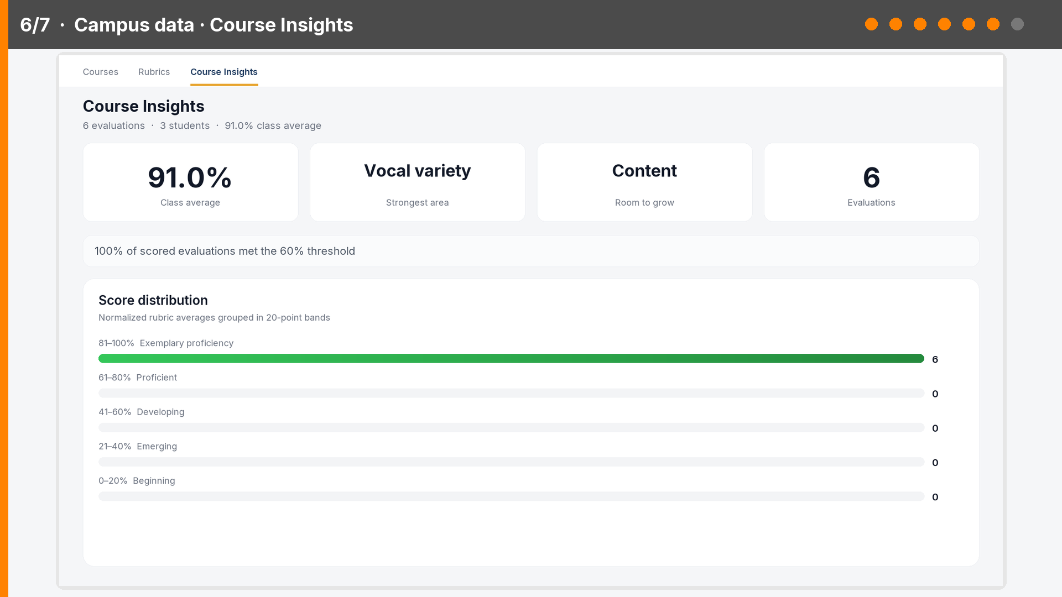
WORKFLOW
Draft → refine → structured campus data
1. Upload + rubric
2. AI draft
3. Instructor refines
4. Saved evaluation
5. Campus data
The grade is not the only product—the instructor-finalized evaluation is reusable evidence.
Upload → feedback → Course Insights metrics (readable) → dashboard · muted · loops
Data xUTK 2026 · Discovery · University of Tennessee, Knoxville
9 / 23
Notes:
Workflow video, muted and looping. Upload, AI draft, instructor feedback detail, then Course Insights: large readable metrics—91 percent class average, strongest Vocal variety, room to grow Content, six evaluations, threshold met, score distribution—then a zoomed dashboard crop of those metrics. The grade is not the only product; instructor-finalized evaluations become reusable course evidence.

Slide 10
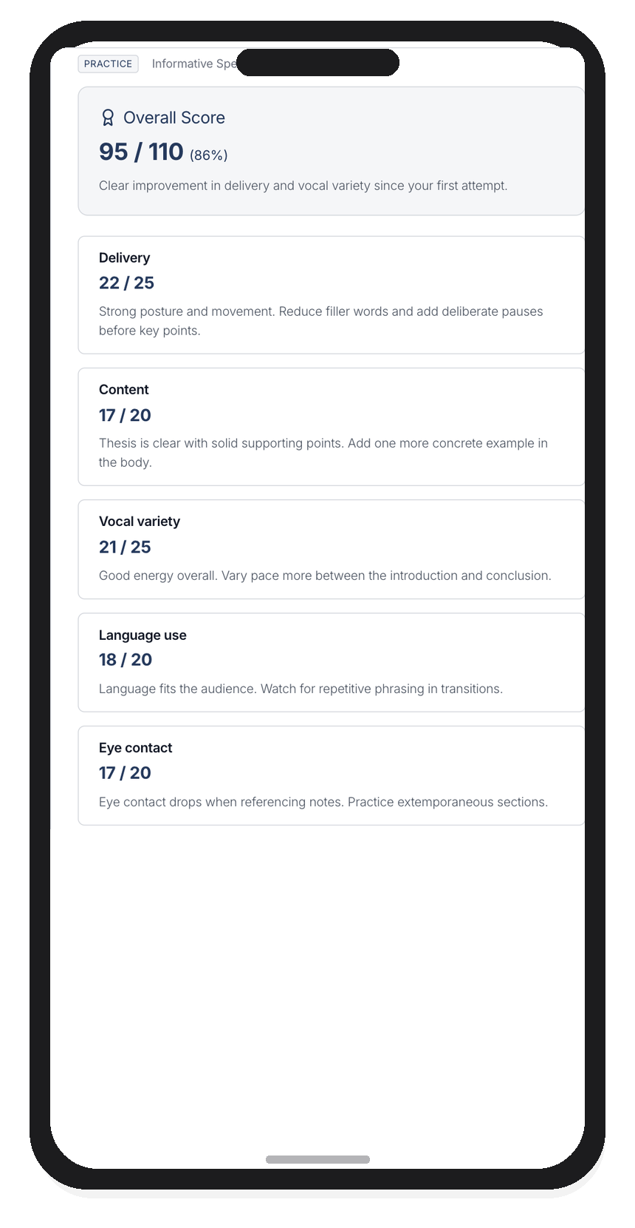
TWO SURFACES · ONE FRAMEWORK
What an assessment looks like—and what the speaker sees
Instructor — evaluation review
Speaker — Practice feedback
Rubric scores, comments, instructor as grader of record
Category scores and guidance after a run
Data xUTK 2026 · Discovery · University of Tennessee, Knoxville
10 / 23
Notes:
Two surfaces, one framework. Left: instructor evaluation review with rubric scores and comments. Right: speaker Practice feedback on mobile with category scores and guidance.

Slide 11
Leveraging data for instructors
Reclaim time for judgment. Surface patterns you can teach from.
Data xUTK 2026 · Discovery · University of Tennessee, Knoxville
11 / 23
Notes:
Section divider: Leveraging data for instructors—reclaim time for judgment and surface patterns you can teach from.

Slide 12
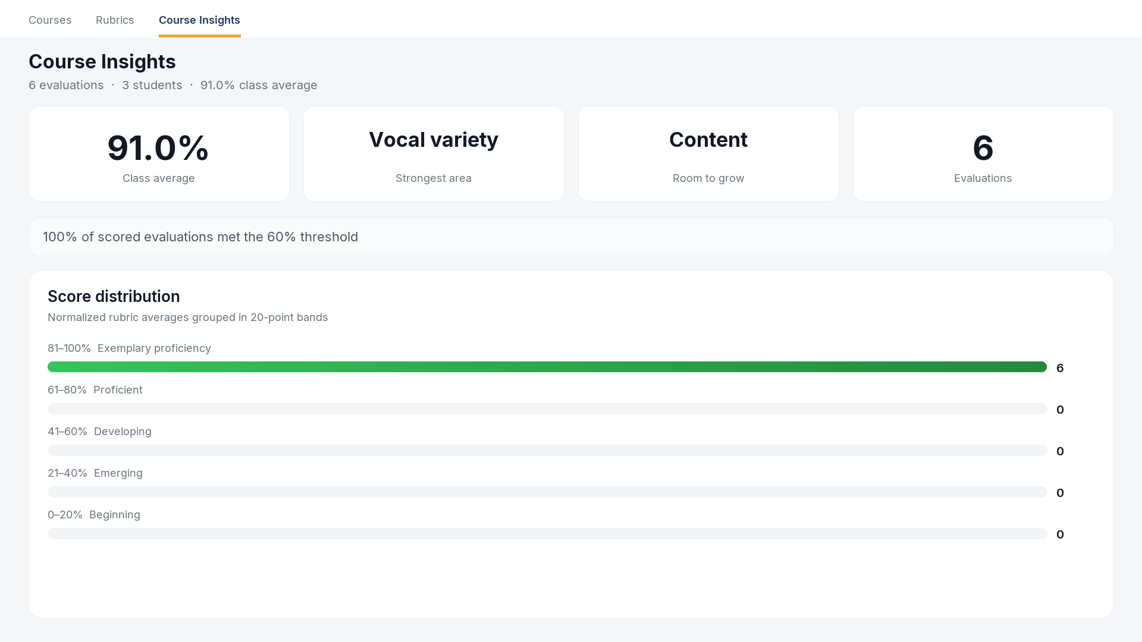
INSTRUCTOR USE CASES
What section-level speech data looks like
AI draft → refine → save · Course Insights patterns · Teach the next speech from the gaps
Data xUTK 2026 · Discovery · University of Tennessee, Knoxville
12 / 23
Notes:
Instructor use cases. SpeechGradebook Course Insights Overview: 91 percent class average, Vocal variety strongest, Content room to grow, six evaluations, threshold met, score distribution in the exemplary band. Teach the next speech from the gaps.

Slide 13
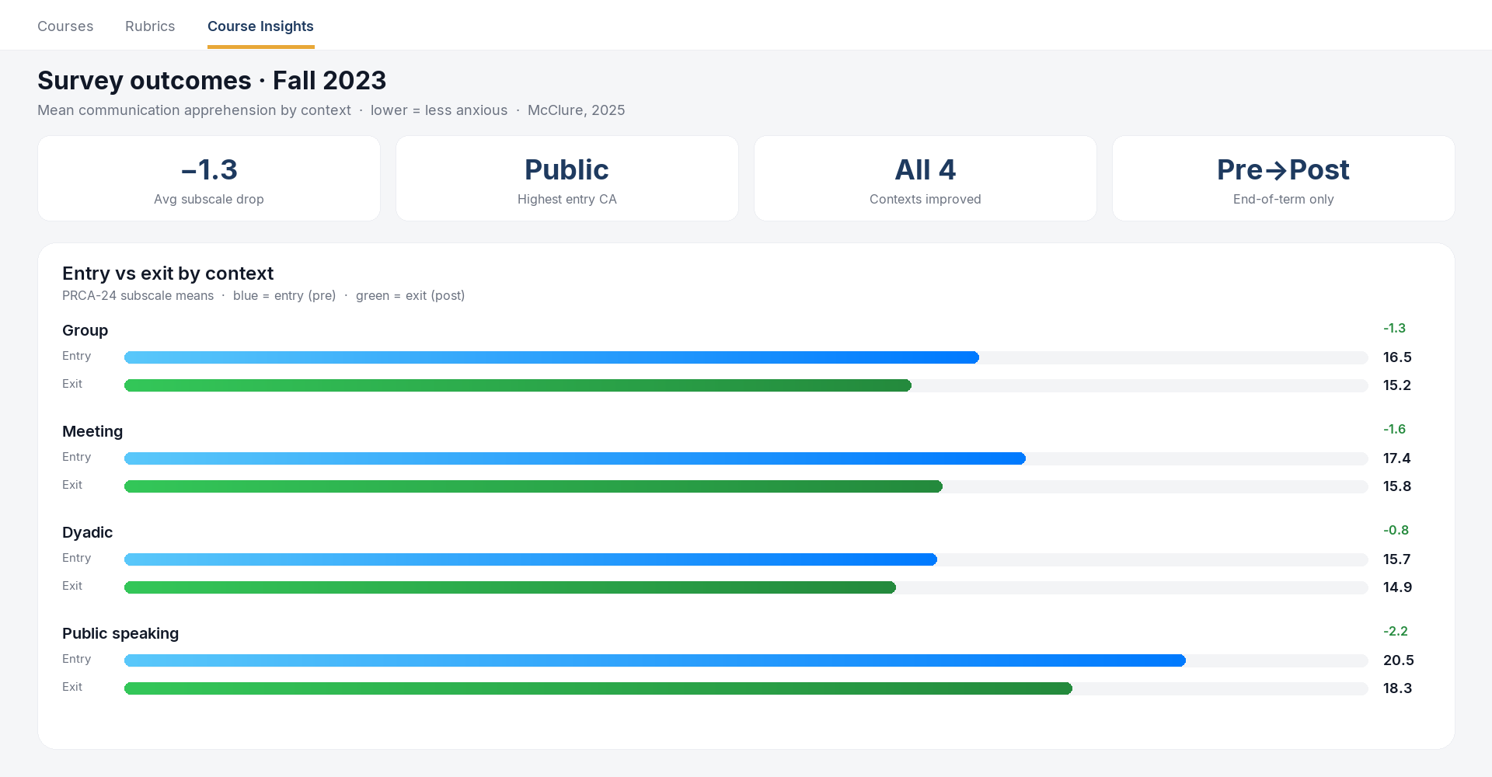
DISSERTATION · FALL 2023
What end-of-term surveys already show
The gap
Overall CA drops are real—and significant—but they arrive after the term.
Instructors still lack mid-course, speech-by-speech category signals between pre and post.
Data xUTK 2026 · Discovery · University of Tennessee, Knoxville
13 / 23
Notes:
Dissertation Fall 2023 shown in a SpeechGradebook-style Course Insights dashboard. Mean communication apprehension by context, entry versus exit. Group, Meeting, Dyadic, and Public speaking all decline. Gap: overall gains arrive after the term; instructors still lack mid-course speech-by-speech category signals.

Slide 14
Leveraging data for administrators
Comparable performance evidence for program discovery and support.
Data xUTK 2026 · Discovery · University of Tennessee, Knoxville
14 / 23
Notes:
Section divider: Leveraging data for administrators—comparable performance evidence for program discovery and support.

Slide 15
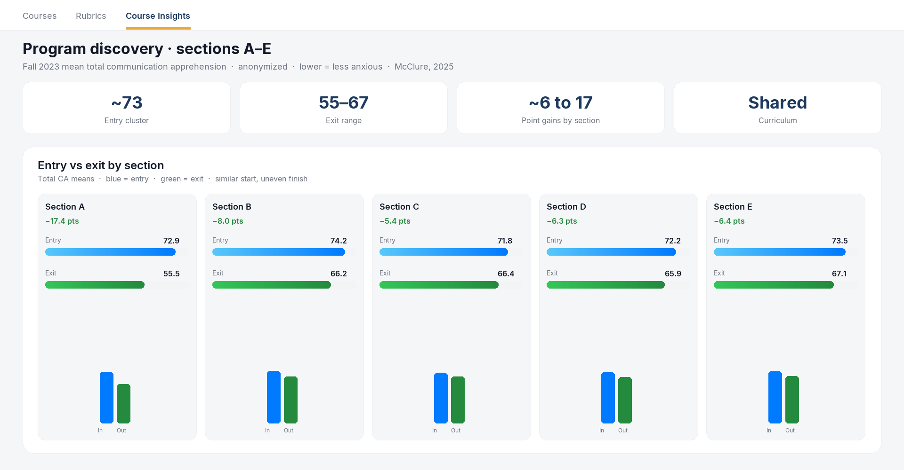
PROGRAM DISCOVERY · MCCLURE, 2025
Sections can exit differently under a shared curriculum
Why admins care
Similar entry (~72–74); exit gains from ~6 to ~17 points by section.
Visibility for support and curriculum—not public ranking.
Survey LOs show the pattern; speech-category data would explain it earlier.
Data xUTK 2026 · Discovery · University of Tennessee, Knoxville
15 / 23
Notes:
Program discovery in a SpeechGradebook-style dashboard: anonymized sections A through E. Similar entry apprehension about 72 to 74; exit gains from about 6 to 17 points by section. Visibility for support and curriculum, not ranking.

Slide 16
ADMINISTRATOR TOOLKIT
What program leads can do with structured speech data
1
2
Aggregate by category
Disaggregate by context
Spot systematic competency gaps across courses
Compare gen-ed vs. major-context (210 vs 240)
3
4
Export for assessment
Stay near workflows
Evidence folders without manual rebuild
Prioritize Canvas I/O—reduce side channels
Data xUTK 2026 · Discovery · University of Tennessee, Knoxville
16 / 23
Notes:
Administrator toolkit: aggregate by category; disaggregate by context such as 210 versus 240; export for assessment; stay near Canvas workflows.

Slide 17
SUMMER 2026 PILOT
Adoption lessons—not an efficacy chart
2
Limited
High
pilot instructors
completed evaluations
value of workflow lessons
Fits Data xUTK’s call for tools, insights, or lessons learned at any stage.
Primary yield: what blocks instructors from creating speech data when listening load is already enormous.
Data xUTK 2026 · Discovery · University of Tennessee, Knoxville
17 / 23
Notes:
Summer 2026 pilot: two pilot instructors, limited completed evaluations, high value of workflow lessons. Fits Data xUTK’s call for lessons learned at any stage.

Slide 18
PILOT DISCOVERY
THE HINGE
Barriers to getting started
Canvas
interoperability
1. Setup friction (courses, rubrics, accounts)
• Rosters
2. Video / submission logistics
• Videos / submissions
3. Another system on top of Canvas
• Scores & feedback returned to the gradebook
4. Trust and data-handling questions
Without it: side channel + thin datasets.
With it: a viable instructional and program data pipeline.
Data xUTK 2026 · Discovery · University of Tennessee, Knoxville
18 / 23
Notes:
Pilot barriers: setup friction, video logistics, another system on top of Canvas, trust and data-handling questions. Hinge is Canvas interoperability for rosters, videos, and returning scores and feedback to the gradebook.

Slide 19
ASSESSMENT DATA LAYER
Survey LOs help—but leave a mid-course gap
Traditional
Pre survey
Course & speeches
Post survey
“Improvement?”
With structured speech evaluation data
Intake self-assessment
Speech rubric categories
Map to LO constructs
Mid-course + program visibility
Data xUTK 2026 · Discovery · University of Tennessee, Knoxville
19 / 23
Notes:
Assessment data layer. Traditional path: pre survey, course and speeches, post survey, then ask about improvement. With structured speech evaluation: intake self-assessment, speech rubric categories, map to LO constructs, mid-course and program visibility.

Slide 20
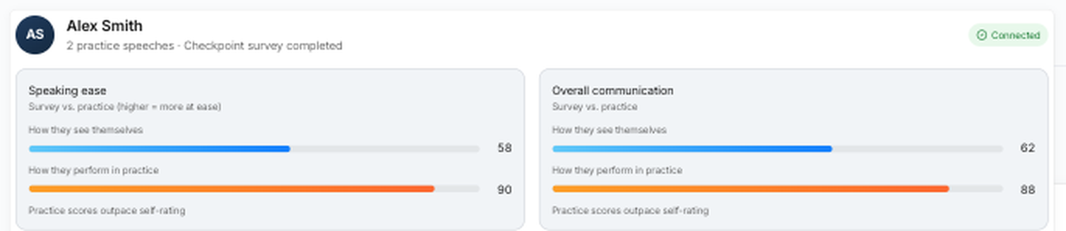
CONCRETE LINKAGE
Performance signals connected to learning outcomes
1. Evidence
2. Construct
3. Campus use
Vocalized pauses and related delivery signals
Speaking comfort / CA trajectory (SGB-CA)
Speaker progress · instructor signal · program LO evidence
Survey vs. practice constructs (upscaled for readability) · informed-by LO tradition, not PRCA-24/CCS
Data xUTK 2026 · Discovery · University of Tennessee, Knoxville
20 / 23
Notes:
Concrete linkage: evidence such as vocalized pauses; construct such as speaking comfort or CA trajectory; campus use for speaker progress, instructor signal, and program LO evidence. Screenshot compares survey versus practice constructs.

Slide 21
TAKEAWAYS
Three discoveries
1
Time + data
Speech evaluation already demands huge listening time. AI-assisted, instructor-refined evaluation can reclaim capacity and leave structured data.
2
Adoption
Barriers to start and Canvas interoperability determine whether that data exists at campus scale.
3
Assessment depth
Linking performance categories to LO constructs strengthens evidence beyond survey-only practices—for instructors and administrators.
Data xUTK 2026 · Discovery · University of Tennessee, Knoxville
21 / 23
Notes:
Three takeaways: time plus data; adoption barriers and Canvas; assessment depth by linking performance categories to LO constructs.

Slide 22

LIVE DEMO
Try the product, don’t just look at screenshots
Best in-room option: open the Practice demo in a browser (full screen), then return to PowerPoint.
Optional: Microsoft 365 “Web Viewer” / LiveWeb add-in can embed a page on a slide if your campus install allows it.
Click the button in slideshow mode, or scan the QR code.
Open Practice demo →
Scan for Practice demo
https://www.speechgradebook.com/practice#demo
Data xUTK 2026 · Discovery · University of Tennessee, Knoxville
22 / 23
Notes:
Live demo. Open Practice demo in a browser, or scan the QR code. URL: https://www.speechgradebook.com/practice#demo

Slide 23
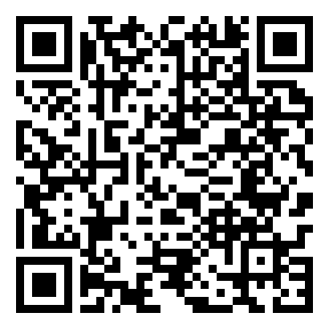
UNIVERSITY OF TENNESSEE, KNOXVILLE
Questions & discussion
Anna Lyn McClure, PhD
Technical Documentation Specialist
Office of Communications and Marketing · UTK
EMAIL
amcclu12@utk.edu
anna@validbound.com
MORE
Scan to join the
mailing list
speechgradebook.com · validbound.com
Next focus: Canvas / LTI for rosters, video, and feedback return.
Data xUTK 2026 · Discovery · University of Tennessee, Knoxville
23 / 23
Notes:
Questions and discussion. Contact amcclu12@utk.edu and anna@validbound.com. speechgradebook.com and validbound.com. QR code for mailing list signup. Next focus: Canvas or LTI for rosters, video, and feedback return.

